Slide 1
Fusion Enterprise Structure
Enterprise
Division
Ledger
Legal Entity
Business Unit
Inventory Orgs
Departments

Slide 2
Fusion Enterprise Structure
Enterprise is mandatory in fusion configuration.
Allowed to create only one Enterprise.
All Organizations are created with in Enterprise
It Captures the names of the Enterprise and headquarters location.

Slide 3
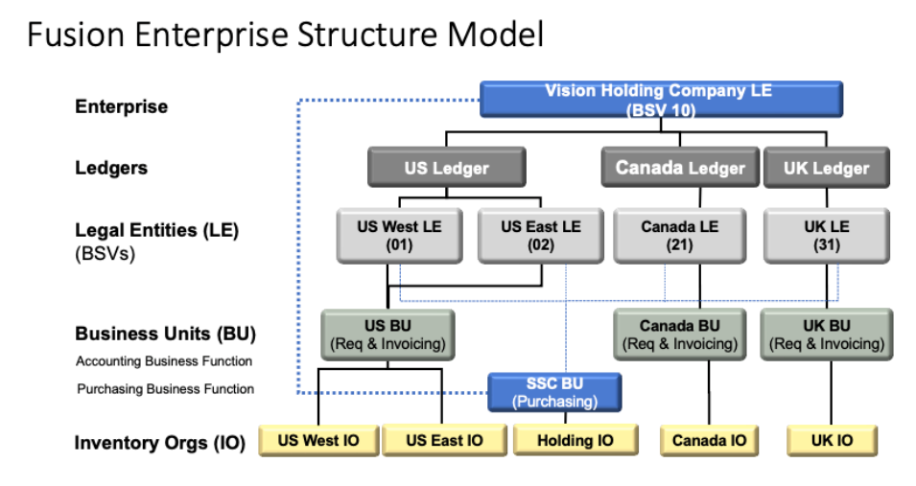

Slide 4
